Slide 1
Crunchy Corner Business
Optimization & Budgeting
By Kasfur Dhuniyan

Slide 2


Understanding The Business
Module 01

Slide 3


About Company
Crunchy Corner Business
Crunchy Corner is one of India largest Fast Foods restaurant chain and serving millions of customer daily across various cities in India with more than 1000 restaurant and have largest SKU in the industry
Subscribe & Share Karo FATAFAT !!

Slide 4
WhatsApp 7718955346
Live Training
4- Sunday
Certificates
3 Months Internship
Rs 5000/-

Slide 5
Understand the Data First To Understand the Business in Better Way….Excel
Subscribe & Share Karo FATAFAT !!

Slide 6
Data Preparation
Data Arrangement : Dimension & Fact able
Data Modelling : Relationship Development for Insight
Subscribe & Share Karo FATAFAT !!

Slide 7
Defining Problem
Client Requirement
We Are Looking For Dashboard where we can check our Financial Performance, How we can Optimize our Business and Budgeting
01
02
03
Financial Overview Metrices
Optimization of Business
Financial Planning & Budgeting
Subscribe & Share Karo FATAFAT !!

Slide 8
Financial Performance Analysis
Module 02

Slide 9
Financial Performance
Overall Sales,Gross Profit,EBITDA,PAT,SKU
01
Show YoY Change for Following (Sales, Gross Profit,EBITDA,PAT)
02
Trend of Sales with PAT with PAT%
03
Show 100% stake Column Chart showing (Sales,Gross Profit,EBITDA,PAT)
04
Show Sales by Category & Location
05
Sales Bifurcation by Channel
06
Subscribe & Share Karo FATAFAT !!
Volume & Trend by Category
07

Slide 10
Financial Performance Steps
To Analyze the Historical Data Always Calculate sum of all Line item Available in Data ,Always Try to avoid Column Total
Calculate for Actual and Budget Both
DAX for Actual & Budget
Subscribe & Share Karo FATAFAT !!

Slide 11
Optimization of Business
Module 03

Slide 12
Optimization of Business
Top Category by Gross Profit & Net Revenue (Scatter Plot)
01
02
Gross Profit & Volume Comparison with Average (Dynamic)
Pareto Analysis (Level 1,2,3)
03
Show highest sales by category and % of SKU Contribution (Mekko Chart)
04
Subscribe & Share Karo FATAFAT !!

Slide 13
Optimization Steps
Will Create Formula every Problem statement defined by the client in order to Complete the Project
DAX Solved for the Problem
Subscribe & Share Karo FATAFAT !!

Slide 14
Quadrant Analysis
Step 1
Quadrant Analysis to Identify category ,Sub Category high Contribution by sales & Gross Profit
Quadrant Analysis to Identify Location high Contribution by sales & Gross Profit
Calculate Gross Profit Margin
Dax
Gross Profit = sum(Actual(Gross_Profit)
Subscribe & Share Karo FATAFAT !!

Slide 15
GP Comparison
Step 1
Gross Profit & Volume Comparison For Category
Calculate Gross Profit Margin
Dax
Gross Profit = sum(Actual(Gross_Profit)
Gross Profit = sum(Actual(Total Volume)
Subscribe & Share Karo FATAFAT !!

Slide 16
Pareto Analysis
Pareto 1
Find out 20% SKU Contributing 80% of the Revenue
Calculate
Cum SKU %
Total Sales
Ranking of SKU By Sales
Cumulative Sales
Calculate Total SKU Sales
Cumulative % = Cum/Total SKU sales
SKU Count
Cumulative sku Count
Subscribe & Share Karo FATAFAT !!
Net SKU Count

Slide 17
Pareto Analysis
Pareto 2
Find out 20% SKU Contributing 80% of the Revenue
Calculate
Des SKU NR
Subscribe & Share Karo FATAFAT !!

Slide 18
Pareto Analysis
Pareto 3
Find out 20% SKU Contributing 80% of the Revenue
Calculate
Pareto Base
Pareto % Top N revenue
Subscribe & Share Karo FATAFAT !!

Slide 19
Show Sales & % SKU
Mekko Chart
Mekko Chart is a type of data visualization that combines elements of bar charts and stacked bar charts to show data distribution across multiple dimensions. It is particularly useful for displaying categorical data across different variables, where both the width and height of the bars represent different metrics.
Calculate
Total Sales
%SKU Over Total SKU
Subscribe & Share Karo FATAFAT !!

Slide 20
Budgeting Analysis
Module 03

Slide 21
Budgeting Analysis
PVM Analysis
01
02
Variance Analysis
Actual Vs Budget Financial Analysis for Business Drivers ( Sales,EBITDA,PAT,Volume) with Trend YoY
03
Actual Vs Budget Financial Analysis for Cost Drivers ( COGS,Packging,Marketing) with Trend YoY
04
Subscribe & Share Karo FATAFAT !!

Slide 22
Budgeting Steps
Will Create Formula every Problem statement defined by the client in order to Complete the Project
DAX Solved for the Problem
Subscribe & Share Karo FATAFAT !!

Slide 23
PVM Analysis
Step 1
PVM Analysis helps to understand the factors affected the business to Increase or Decrease
Here We are showing Total Amount of Sales for the Given Dates
Column Dax
Day = DAY(ListOfOrders[Order Date].[Date])
Calculated Measures
Sales by Day = calculate([Total Sales],groupby(ListOfOrders,ListOfOrders[Day]))

Slide 24
Advanced DAX Function
Module 14.7

Slide 25
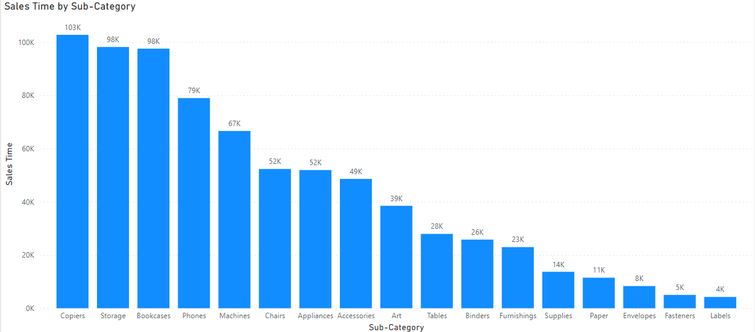
Advance Dax
Selectedvalue Function
Calculate monthly and ytd sales for each sub category?
Here we are showing monthly and ytd sales for each sub category
Calculated Measures
Sales Time = IF(SELECTEDVALUE(Timeframe[Timeperiod])="Monthly",
SUM(OrderBreakdown[Sales]),
IF(SELECTEDVALUE(Timeframe[Timeperiod])="Ytd",
CALCULATE(SUM(OrderBreakdown[Sales]),
FILTER(all(ListOfOrders),ListOfOrders[Order Date]<=MAX(ListOfOrders[Order Date])&&
ListOfOrders[Order Date].[Year]= max(ListOfOrders[Order Date].[Year])))))

Slide 26
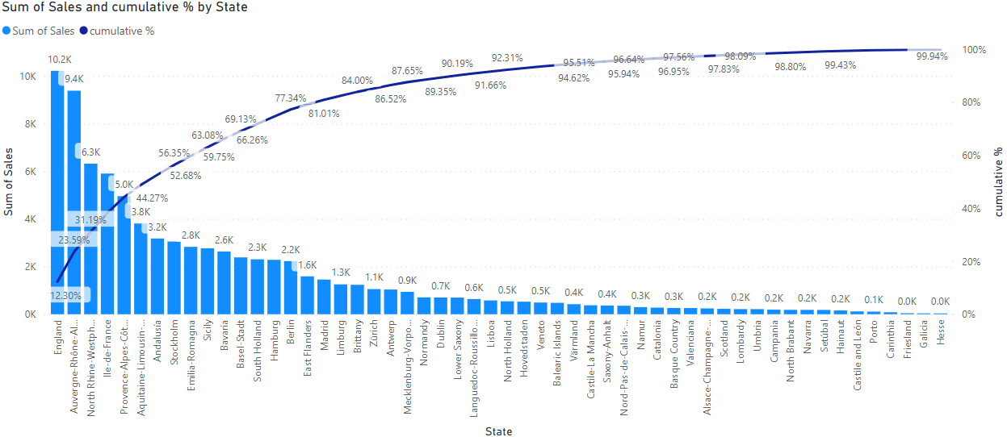
Advance Dax
Cumulative %
Calculate Cumulative Sales %?
Here we are showing cumulative sales%.
Calculated Measures
Cumulative % = Var sales = SUM(OrderBreakdown[Sales])
return
DIVIDE(
CALCULATE(SUM(OrderBreakdown[Sales]),
FILTER(
ALLSELECTED(ListOfOrders[State]),
CALCULATE(SUM(OrderBreakdown[Sales])>=sales))),
[All sales])

Slide 27
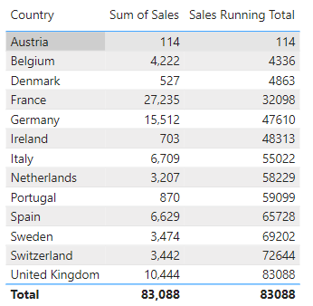
Advance Dax
Running Total
Calculate Running total sales?
Here we are showing running total sales.
Calculated Measures
Sales Running Total = CALCULATE([Sales Time],FILTER(ALL(ListOfOrders[Country]),
ListOfOrders[Country]<=MAX(ListOfOrders[Country])))

Slide 28
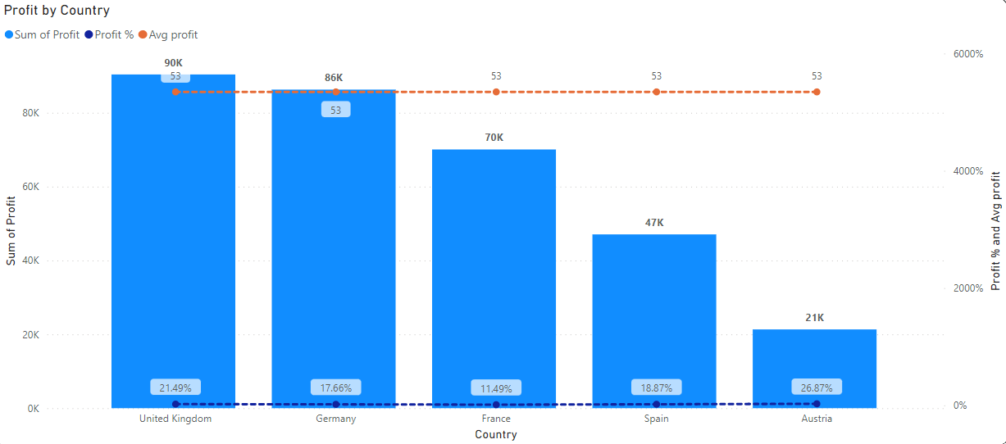
Advance Dax
Top N (Ranking)
Calculate profit making top countries?
Here we are showing profit making top countries.
Calculated Measures
Rank country =
Var A = RANKX(ALL(ListOfOrders[Country]),[Profit],,DESC)
Var B = IF(HASONEVALUE('Top N Country'[Top N Country]), MIN('Top N Country'[Top N Country]),20)
Return
IF(A<=B,1,0)

Slide 29
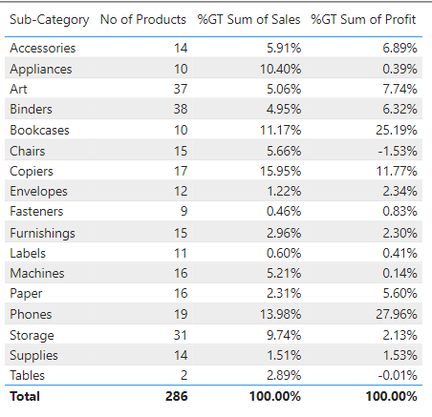
Advance Dax
Product Contribution
Calculate Sales & Profit contribution for each sub category?
Here we are showing sales & profit contribution for each sub category.

Slide 30
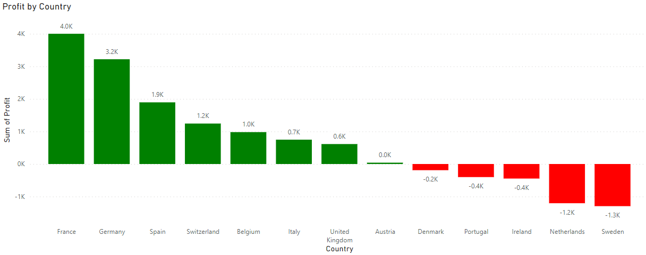
Advance Dax
Conditional formating
Apply conditional formatting using dax?
Here we are showing green bars for
Positive profit and red bars for negative profit.
Calculated Measures
Conditional formatting = IF(SUM(OrderBreakdown[Profit])>0,"Green",
IF(SUM(OrderBreakdown[Profit])<0,"Red"))

Slide 31
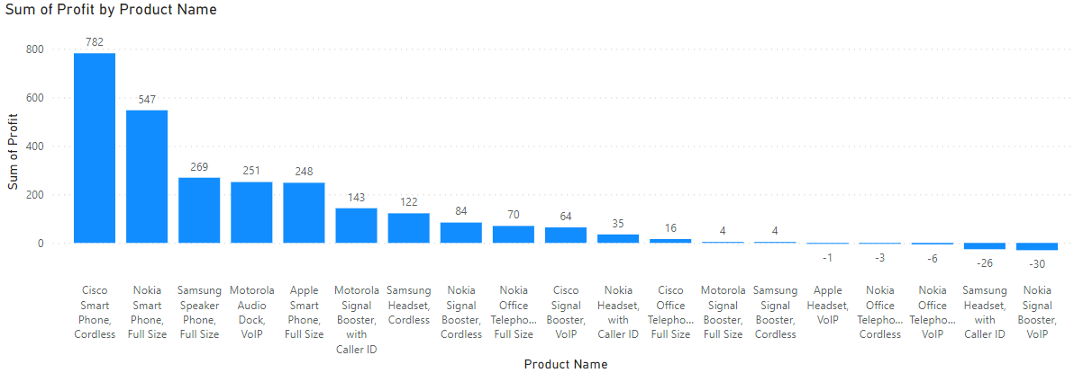
Advance Dax
Active Products
Calculate Total Active products?
Here we are showing active products till date.
Calculated Measures
Active Products till date =
IF (
HASONEFILTER ( OrderBreakdown[Product Name] ),
IF ( SELECTEDVALUE ( OrderBreakdown[Product Name] ) IN VALUES ( OrderBreakdown[Product Name] ), 1, 0 ),
SUMX (
VALUES ( OrderBreakdown[Product Name] ),
CALCULATE (
IF ( SELECTEDVALUE ( OrderBreakdown[Product Name] ) IN VALUES ( OrderBreakdown[Product Name] ), 1, 0 ))))

Slide 32
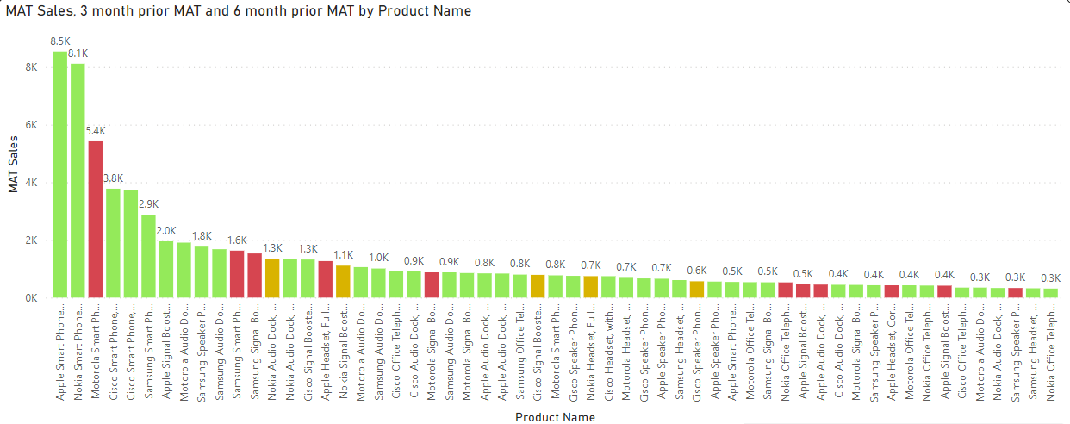
Advance Dax
MAT
Calculate 3 month prior and 6 month prior MAT and highlight loss making and profit making products?
Here we are showing 3 month prior and 6 month prior MAT and highlight loss making and profit making products.
Calculated Measures
3 month prior MAT = CALCULATE([MAT Sales],DATESINPERIOD(ListOfOrders[Order Date].[Date],EOMONTH(MAX(ListOfOrders[Order Date]),-3),-3,MONTH))
MAT conditions =
IF([MAT Sales]< [6 month prior MAT],1,
IF([MAT Sales]< [3 month prior MAT],2,3))

Slide 33
THANK YOU
www.finkaro.com

